Slide 1
WATSON
By Pradeep Gopinathan, Vera Kutsenko and Joseph Staehle

Slide 2
Overview
Introduction – What is Watson?
The Jeopardy! Challenge
Hardware
Sentence and Question Comprehension
Question Answering
Watson and Medicine
An Aside - The Effectiveness of Data

Slide 3
Introduction
Watson is a supercomputer QA system
Arose out of interest in Deep Blue
Analysis of Jeopardy Questions
Tremendous amounts of parallel processing
Combination of myriads of nlp algorithms

Slide 4
What is Jeopardy!
Quiz show that started in 1984
Three rounds with three people
In the first two rounds, the questions are organized into six columns and five rows.
A player selects a cell in the grid by selecting category and dollar value
After the host reads the revealed clue outloud, each player is equipped with a buzzer they must press as quickly as possible to answer the question
The player must correctly answer the question in 5 seconds in a form of a question
  If correct then player gains the dollar value, otherwise he looses

Slide 5
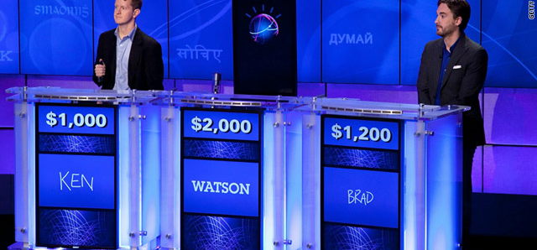
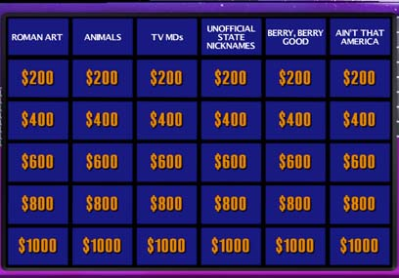

Slide 6
Why choose Jeopardy!
rich natual language questions
broad range of categories requiring a tremendous amount of general knowledge
Requires fast computation and response time
Requires the ability to pick up on nuances, irony, riddles, puns
Requires distinguishing what is being asked for and synthesizing answers based on human knowledge

Slide 7
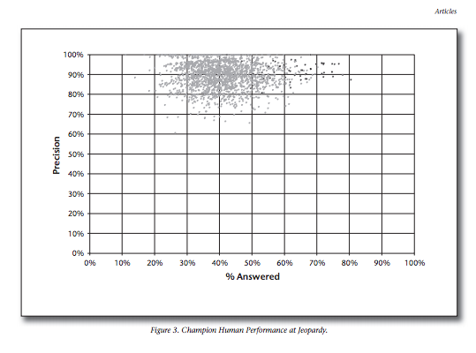

Slide 8
Examples of Jeopardy Questions
Question Classification: Decomposition Question
Category: “Rap” Sheet
Clue: This archaic term for a mischievous or annoying child can also mean a rogue or scamp.
Subclue 1: This archaic term for a mischievous or annoying child.
Subclue 2: This term can also mean a rogue or scamp.
Answer: Rapscallion
Question Classification:
Puzzle
Category: Rhyme Time
Clue: It’s where Pele stores his ball.
Subclue 1: Pete ball (soccer)
Subclue 2: where store (cabinet, drawer, locker, and
so on)
Answer: soccer locker
Notes:
First clue: watson must be able to pick out that the question has two subclues. Therefore, searching for answers for both clues and see if there are overlapping answers may prvide the appropriate answers.
For the second clue, watson must be able to put together that a type of ball must rhyme with a place where one can store it. As you can see, for humans this may be easier because of the common knowledge that we have acquired, but for watson this can actually be a challenge. It must be able to piece the two together with no previous knowledge like we may have
8

Slide 9
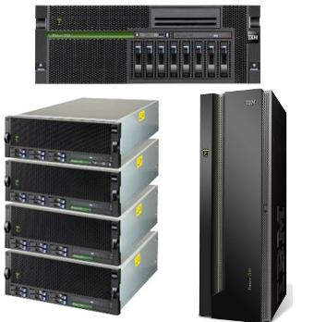
Watson Hardware
10 refridgerator sized system
92 POWER750 systems
  4 Power7 processors: 8 core, 4 SMT threads
15 Terabytes of memory used for Jeopardy game
Each Power7 is linked via cable to every other Power7 system. Fiber cables are used to link to hardware, stable storage
Notes:
Watson constitutes of a 10 rack system with each being a size of a refridgerator
Each rack contains 10 Power7 Machines that contains chips running at (on chip bandwidth) 500 Gb/s with 8 cores that can run 4 threads
Watson, in its entirety, uses about 15 Terabytes of memory storing a 1,000,000 books worth of information for the Jeopardy! game.
9

Slide 10
Watson Hardware
http://www.youtube.com/watch?v=iBpcwjKyDRo

Slide 11
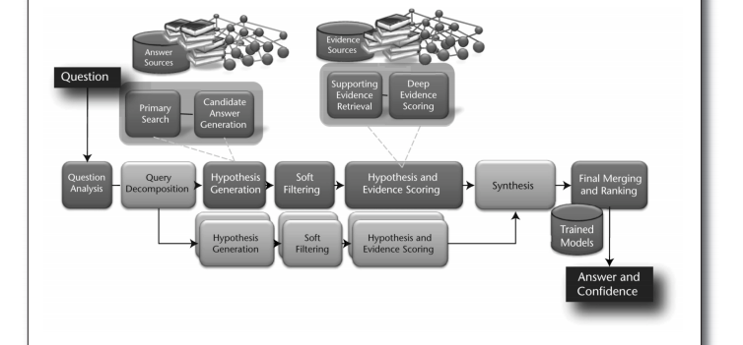

Slide 12
Foundation
Slot Grammar parser ESG: initial parsing of sentence to build tree showing logical and grammatical structure
Predicate-Argument Structure builder: simplify ESG tree by mapping small variations in syntax to common forms
Named Entity Recognizer: looks for names, quantities locations
Coreference Resolution Component: Connects referring expressions (ie. pronouns) to their correct subjects
Relation Extraction Component: Looks for semantic relationships (wherein terms have similar meanings) in text

Slide 13
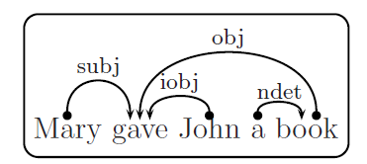
Slot Grammar
Based off slots:
  Syntactic roles of phrases (ie. subject)
  Semantic significance
  (arguments for predicates
  that represent phrases)

Slide 14
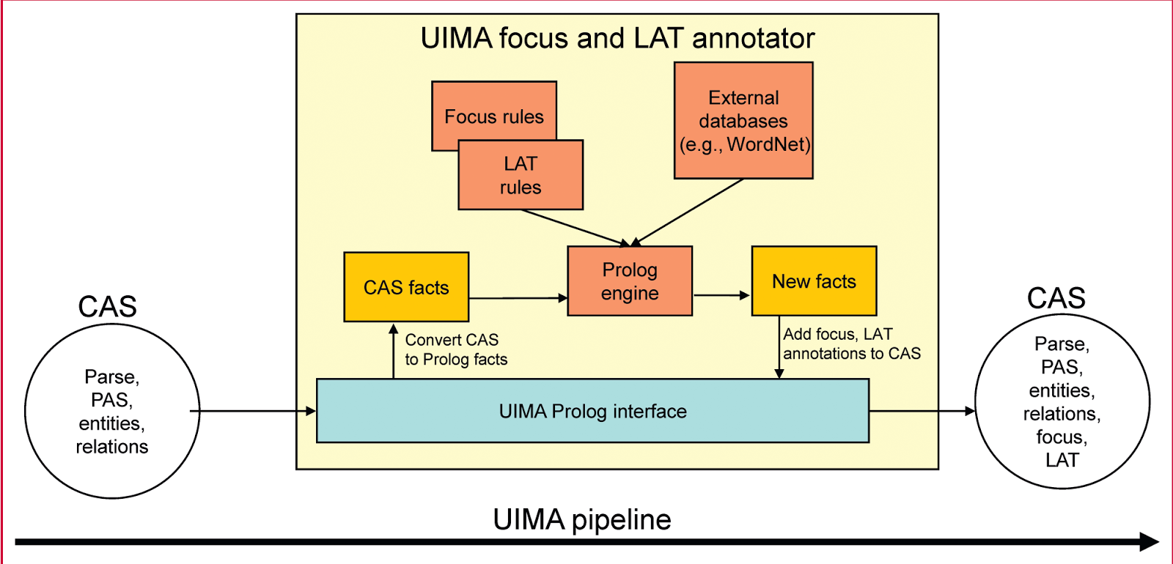

Slide 15
Rules Based Analysis
Analysis rules are implemented in Prolog, a language emulating First Order Logic
  Ex: authorOf(Author, Composition) :- createVerb(Verb), subject(Verb, Author), author(Author), object(Verb, Composition), composition(Composition).-
Done for efficiency and to make use of the full pattern-matching capabilities of Prolog.

Slide 16
Focus
The focus is the part of the question that is a reference to the answer.
Watson finds a focus after parsing the question by looking for one of several patterns:
A noun phrase with determiner "this" or "these"
The pronoun "one”
Example: When hit by electrons, a phosphor gives off electromagnetic energy in this form”

Slide 17
Lexical Answer Types (LAT)
LATs are terms in the question that indicate what type of entity is being asked for.
Watson generally looks at the focus, save for exceptions.
Sometimes will take the LAT from the category, if it meet some rules.
Most frequent LATs coming from previous Jeopardy! sets include: he, country, city, man, film, state, she, author… etc

Slide 18
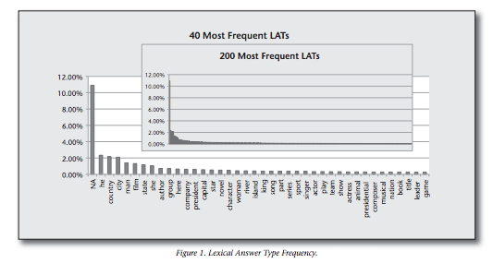

Slide 19
Question Classification
Question Classification identifies the question as belonging to one or more of several broad types
- In jeopardy, this can include types such as puzzle question, math question, definition question…
Basically researchers looked through Jeopardy questions and found numerous patterns in the types of questions being asked, then trained Watson to recognize them
Identified either by Prolog rules over the PAS or by regular expressions over the text

Slide 20
Question Sections (QSections)
QSections are question fragments whose interpretation requires special handling.
Similar to Question Classification, but instead looking for phrases or clauses that help describe the question, like a listing of choices in a multiple choice question.
Example: THE SOUTHERNMOST CAPITAL CITY: Helsinki, Moscow, Bucharest.

Slide 21
Answer Generation
Next Watson must produce a set of “candidate” answers to the question at hand
HOW? Primary Search – Searches for potentially answer-bearing content (documents, encyclopedia entries, etc.)
  This content is then gleaned for candidate answers
  Watson produces several hundred candidates at this stage, cannot answer correctly if it misses here

Slide 22
Hypothesis Generation
Each potential answer is plugged back into the original question in place of the focus
  This is now considered a “Hypothesis” that Watson must gather evidence to support
  Example: “He was presidentially pardoned in September 8…”
    “Nixon was presidentially pardoned in September 8…”
    “Ford was presidentially pardoned in September 8…”

Slide 23
Soft Filtering
Way to tune accuracy vs performance speed
Utilizes lightweight scoring algorithms to prune the initial set of candidate answers
  e.g. Likelihood that candidate is actually a member of the desired LAT
Watson currently lets ~100 candidates through the soft filtering stage (optimal tuning)

Slide 24
Evidence Retrieval
Additional documents are now retrieved to be checked for evidence to support each remaining hypothesis
  e.g. retrieve all documents that contain the candidate answer
  Even better: Redo the original primary search query but add the new candidate phrase as a required portion
    Helps establish context that is necessary for effective scoring/judging

Slide 25
Scoring
Watson using a number of scoring techniques in order to judge the quality of a hypothesis based on its evidence
  System is designed to allow any number of scorers to be plugged in independently
Watson employs more than 50 “scorers”
  Formal probabilities, counts, categorical features
  Geospatial, temporal relationships
  Popularity/Obscurity
Scores are furthermore combined into an evidence profile with aggregate dimensions
  e.g. popularity, location, temporal relationship, source reliability characteristics

Slide 26
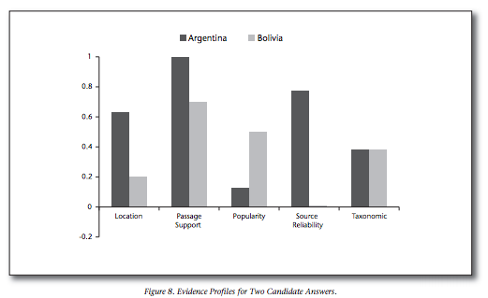

Slide 27
Ranking & Determining Confidence
Potential answers must be merged before they are ranked
  Don't want redundancy in terms that are ranked (e.g. “Abraham Lincoln” and “Honest Abe”
Scores of merged terms are merged as well
  Overall confidence determined from machine-learned model that determines how much contribution each scorer should give to final score
Finally, score with highest confidence is returned and Watson only “answers” if its confidence is above a certain threshold

Slide 28
Watson in the Medical Field
Memorial Sloan-Kettering testing Watson's capabilities at diagnosing illnesses
  Feeding it with clinical cases and medical information
  Acting as Watson's “tutor”
Ability to utilize unstructured data (such as doctors' notes, academic journals) is crucial for success
  Confidence interval is also useful to physicians
Jury's out on how successful it can be, but represents a larger shift in the field of healthcare

Slide 29
Aside: The Effectiveness of Data
Data becomes necessary when the problem at hand does not reduce to an elegant formula
  e.g. economics, natural language
Progress in natural language field has been made not because it is easier, but because there is more data
Simpler models + Large dataset > Complex models + small dataset
  Phrase tables vs. n-gram probabilistic analysis
Suggests general analysis is not always better than specific memorization

Slide 30
Food for Thought
Is Watson proof that the way to solve the most daunting tasks facing computer science is through a data-intensive approach?
Is there other proof/disproof of this in the field today?
With more data, could the next Watson be created much simpler and still be just as/even more effective?
What about the hardware?

